Slide 1
Data Preprocessing Using Web Interface
4-1 project seminar presented by
Batch E-3
Gundla Kavya(18311A05T3)
Chityala Udhay(18311A05R4)
Rishabh Semwal(18311A05W2)
Project Internal Guide & Coordinator
Archana Nagelli

Slide 2
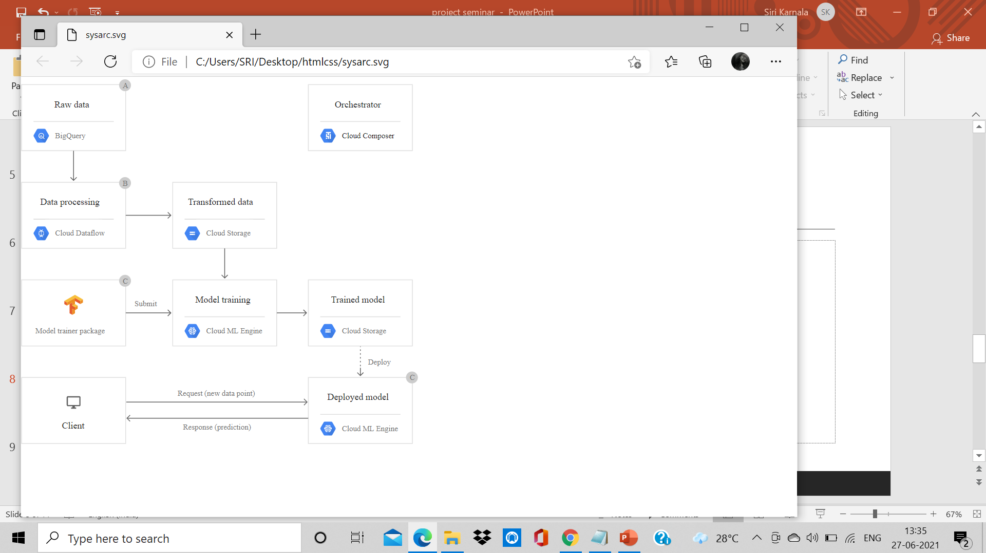
System Architecture
A system architecture is the conceptual model that defines the structure, behavior and more views of a system. An architecture description is a formal description and representation of a system, organized in a way that supports reasoning about the structures and behaviour's of the system.

Slide 3
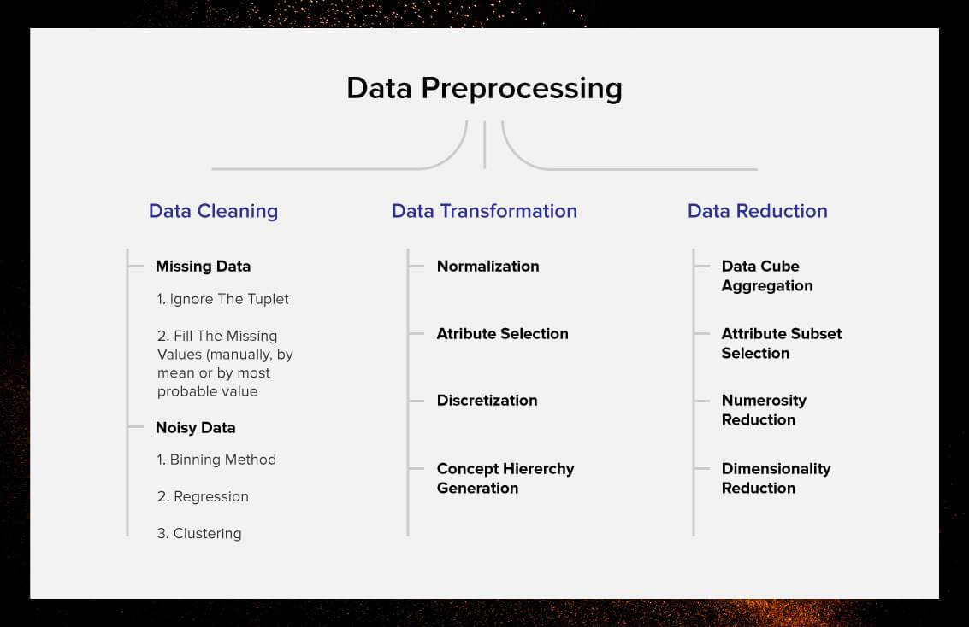
Flow Chart
A flowchart is simply a graphical representation of steps. It shows steps in sequential order and is widely used in presenting the flow of algorithms, workflow or processes. Typically, a flowchart shows the steps as boxes of various kinds, and their order by connecting them with arrows.

Slide 4
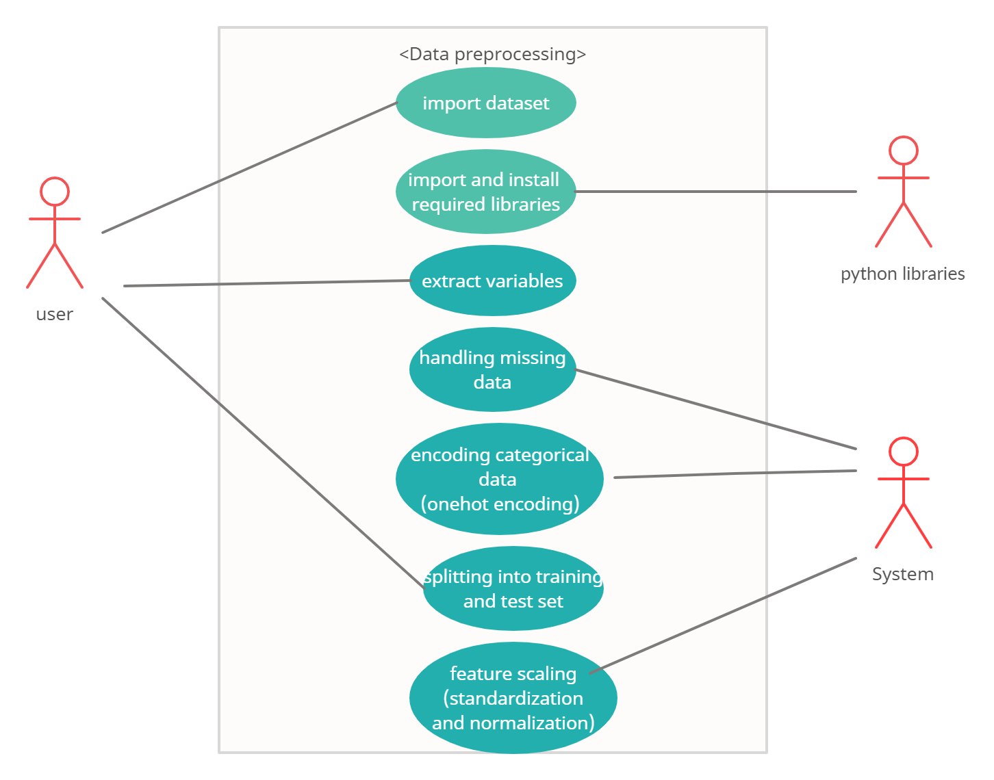
Usecase Diagram
A use case diagram is a graphical depiction of a user's possible interactions with a system. A use case diagram shows various use cases and different types of users the system has and will often be accompanied by other types of diagrams as well. The use cases are represented by either circles or ellipses. The actors are often shown as stick figures.

Slide 5
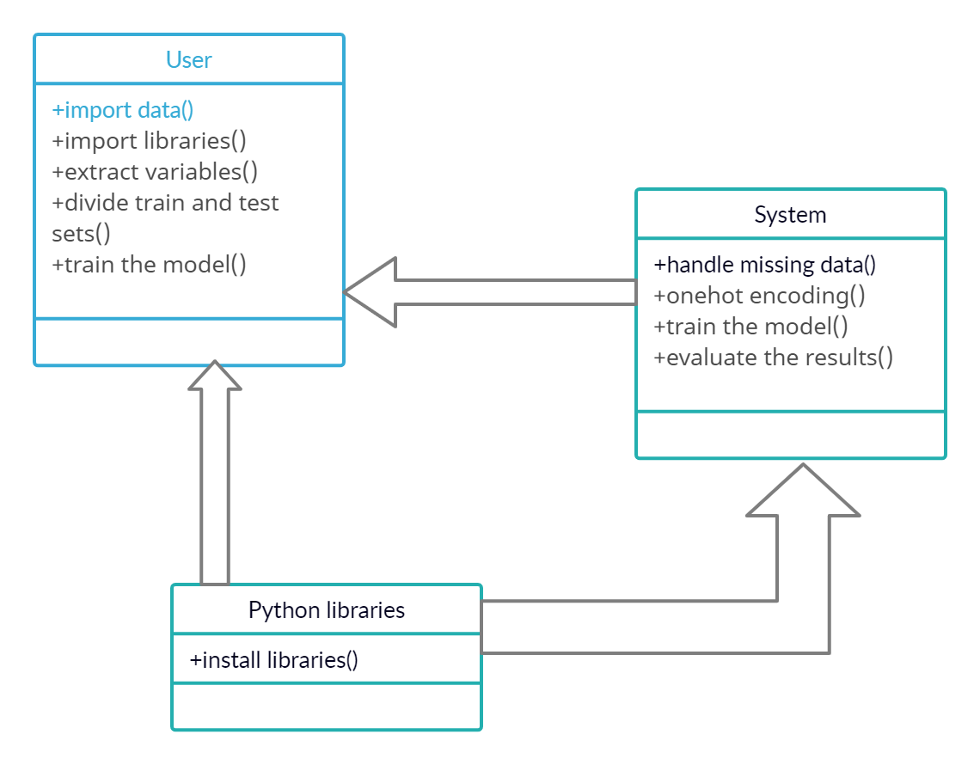
Class Diagram
Class diagram is a static diagram. It represents the static view of an application. Class diagram shows a collection of classes, interfaces, associations, collaborations, and constraints. It is also known as a structural diagram.

Slide 6
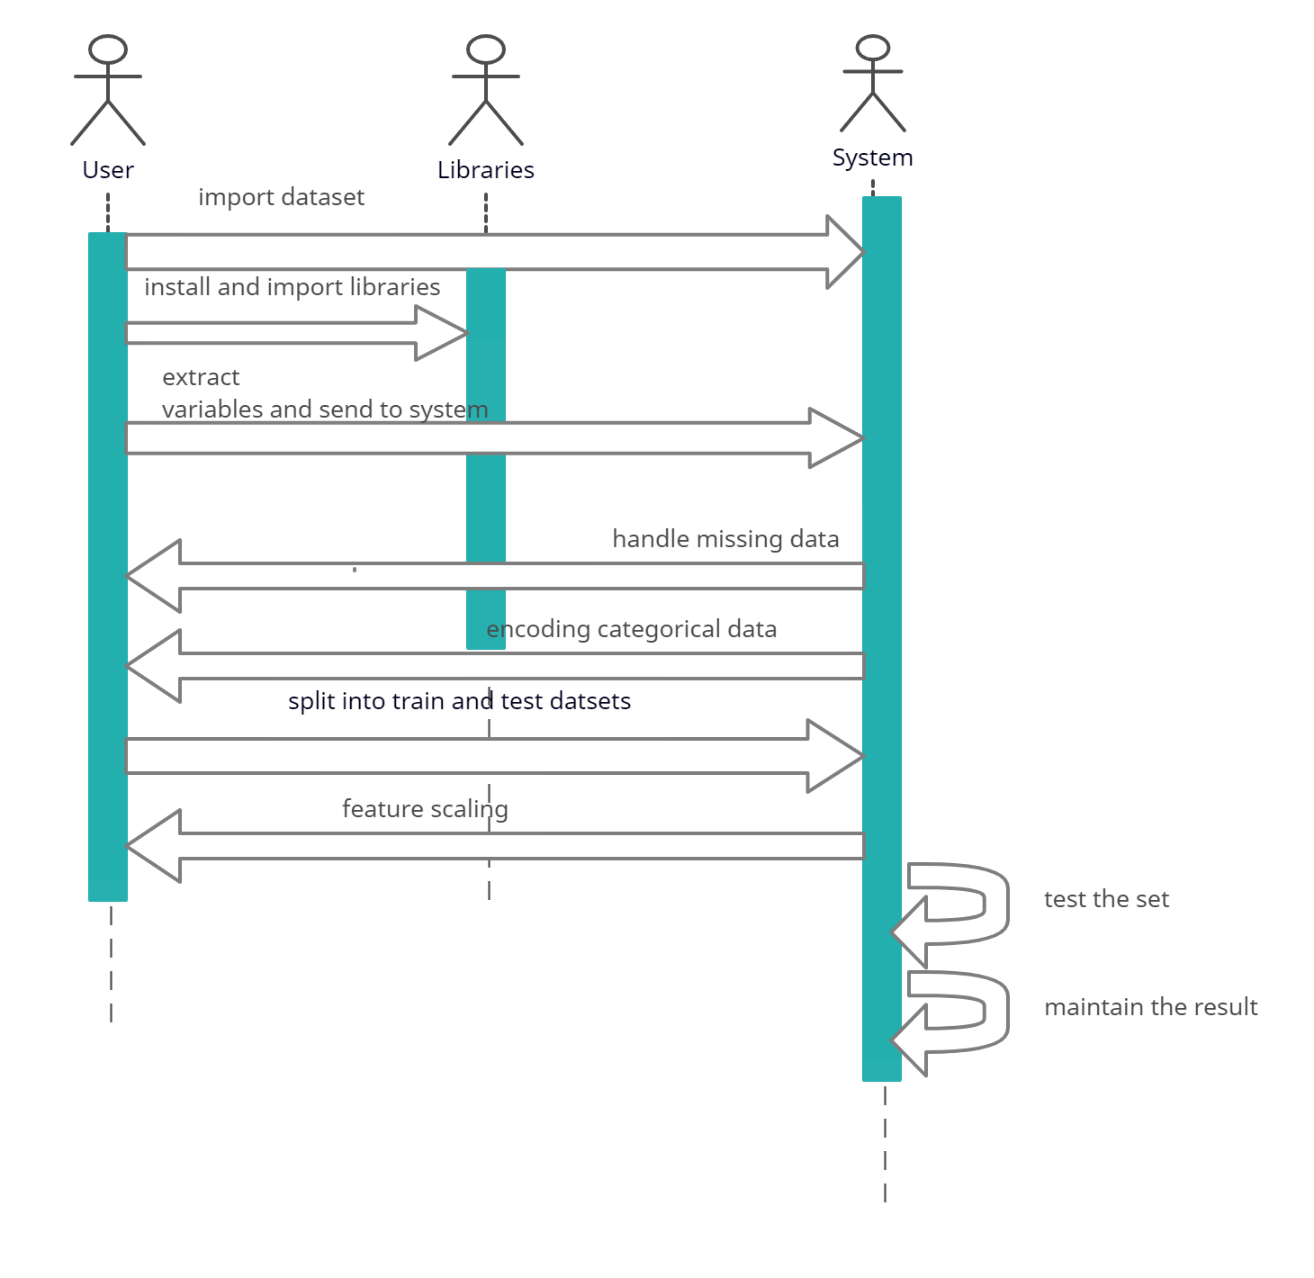
Sequence diagram
A sequence diagram is a type of interaction diagram because it describes how and in what order a group of objects works together. Sequence diagrams are sometimes known as event diagrams or event scenarios.

Slide 7
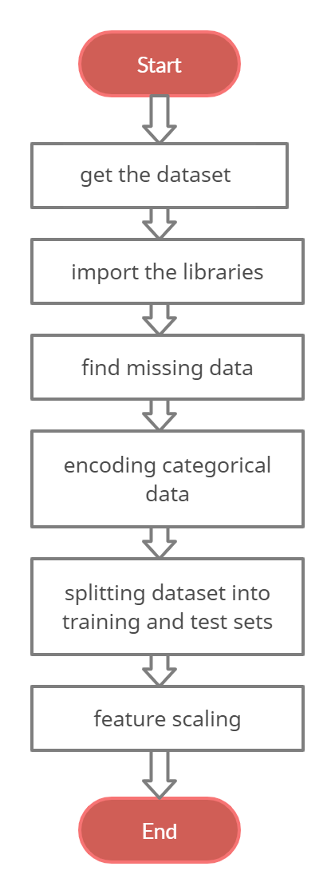
Activity Diagram
An Activity in the activity diagram is also known as Activity state. It is used to represent the invocation of operation, a step in an entire business process. Swimlane is a way in which the performed activities can be grouped by the same actor on an Activity diagram

Slide 8
THANK YOU

